Slide 1
European Grid –
Federated Approach
Dieter Kranzlmüller
(GUP, Joh. Kepler University Linz)
contact@eu-egi.org

Slide 2
















Grids in Europe
Examples of National Grid projects:
  Austrian Grid Initiative
  Belgium: BEgrid
  Cyprus: CYGrid
  France: Grid’5000
  Germany: D-Grid; Unicore
  Greece: HellasGrid
  Grid Ireland
  Italy: INFNGrid; GRID.IT
  The Netherlands: DutchGrid
  Scandinavia: NDGF
  Portugal: Portuguese Grid
  Switzerland: Swiss Grid
  United Kingdom: National Grid Service; OMII; GridPP
  …
Notes:
Average of 180 M€ per year since 2002 (national + EC)

Slide 3









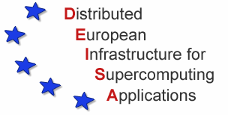







Evolution
National
Global
Testbeds
Routine Usage
Utility Service

Slide 4
Why Sustainability
“Many communities rely on Grids”
What happens, if grid funding ends?
What happens, if “the grid” is turned off?
Compare
Grids vs. electric power grids
Grids vs. research networks

Slide 5
Why Sustainability TODAY?
Dependency:
Some application domains depend on grids already today
Protection of Investment:
Investment in grids, both from funding organizations and from users, need to be protected
Perspective:
Today’s grid users are grid enthusiasts, tomorrows grid users ask for a longer term perspective
➔ Sustainability is the logical next step

Slide 6

e-Infrastructure
Reflection Group (e-IRG)
Mission:
… to support on the political, advisory and monitoring level, the creation of a policy and administrative framework for the easy and cost-effective shared use of electronic resources in Europe (focusing on Grid-computing, data storage, and networking resources) across technological, administrative and national domains.
Drafted in Rome on 10 December 2003
www.e-irg.org

Slide 7
e-Infrastructure
Reflection Group (e-IRG)
European Vision
for a universal e-Infrastructure for research
“An environment where research resources
(H/W, S/W & content) can be readily shared and accessed wherever this is necessary to promote better and more effective research”
  Malcolm Read (Ed.) http://www.e-irg.org/meetings/2005-UK/ A_European_vision_for_a_Universal_e-Infrastructure_for_Research.pdf

Slide 8
e-IRG Delegates Meeting, London, 12/2005
Recommendation:
“The e-IRG recognises that the current project-based financing model of grids (e.g., EGEE, DEISA) presents continuity and interoperability problems, and that new financing and governance models need to be explored – taking into account the role of national grid initiatives as recommended in the Luxembourg e-IRG meeting.”

Slide 9
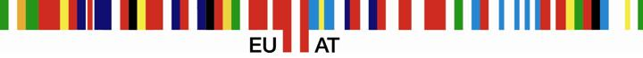
e-IRG Recommendations on Sustainable e-Infrastructures
I: governments and the Commission should develop policies and mechanisms to encourage increased investment in a more coherent and interoperable way across Europe
II: the existing e-Infrastructure projects must be superseded by integrated sustainable services at national and European levels
III: e-Infrastructures must be application-neutral and open to all user communities and resource providers. National funding agencies should be encouraged to fund multi-disciplinary and inclusive infrastructures rather than disciplinary-specific alternatives

Slide 10
e-IRG Recommendations on Sustainable e-Infrastructures
IV: e-Infrastructures must inter-operate and adopt international standard services and protocols in order to qualify for funding
V: the Commission should, within the seventh Framework Programme, develop a pan-European e-Infrastructure which explicitly encourages the further integration of national e-Infrastructure initiatives
e-IRG Task Force on Sustainable e-Infrastructures (SeI)
http://www.e-irg.org/publ/2006-Report_e-IRG_TF-SEI.pdf

Slide 11

European Commission
“…for Grids we would like to see
the move towards
long-term sustainable initiatives
less dependent upon
EU-funded project cycles”
Viviane Reding, Commissioner, European Commission, at the EGEE’06 Conference, September 25, 2006

Slide 12
Towards sustainable grid-empowered
e-Infrastructures
Sustainable
grid/data-based e-Infrastructures
(utility model)
Sustainable
e-Infrastructures
(utility model)
FP7
Production quality
facilities
FP6
Broad scale test-beds
FP5
Slide courtesy of Kyriakos Baxevanidis, EC

Slide 13
The first e-Infrastructure Call in FP7
Support conceptual design studies for new RI (or major upgrades of existing ones) of clear European dimension and interest; such studies will help to assess technical and financial feasibility of proposed new RI
Action should also foster emergence of new organisational models to consolidate a sustainable approach to e-Infrastructures, in particular in the domain of grids and data repositories
New service provisioning schemes to be more neutral and open to all user communities and resource providers
Year 2007
Year 2008
Year 2009
Publication: early 2007
Closure: spring 2007
e-Science Grid Infrastructures
Scientific Digital Repositories
Deployment of e-Infrastructures for new
Scientific Communities
New Research Infrastructures – Design studies
New Research Infrastructures – Preparatory phase
Support measures (studies, policy initiatives,
international co-operation,…)
Slide courtesy of Kyriakos Baxevanidis, EC

Slide 14
Evolution
National
European
e-Infrastructure
Global
Testbeds
Routine Usage
Utility Service

Slide 15
European Grid Initiative
Goal:
Long-term sustainability of grid infrastructures in Europe
Approach:
Establishment of a new federated model bringing together NGIs to build the EGI Organisation

Slide 16
Characteristics of NGIs
Each NGI
… should be a recognized national body
with a single point-of-contact
… should mobilise national funding and resources
… should ensure an operational national grid infrastructure
… should supports user communities (application independent, and open to new user communities and resource providers)
… should contribute and adhere to international standards and policies
Responsibilities between NGIs and EGI are split
to be federated and complementary

Slide 17
European Grid Initiative
Goal:
Long-term sustainability of grid infrastructures in Europe
Approach:
Establishment of a new federated model bringing together NGIs to build the EGI Organisation
EGI Organisation:
Coordination and operation of a common multi-national, multi-disciplinary Grid infrastructure
  To enable and support international Grid-based collaboration
  To provide support and added value to NGIs
  To liaise with corresponding infrastructures outside Europe

Slide 18
EGI Objectives
Ensure the long-term sustainability of the European e-infrastructure
Coordinate the integration and interaction between National Grid Infrastructures
Operate the European level of the production Grid infrastructure for a wide range of scientific disciplines to link National Grid Infrastructures

Slide 19
Provide global services and support that complement and/or coordinate national services (Authentication, VO-support, security, etc);
Coordinate middleware development and standardization to enhance the infrastructure by soliciting targeted developments from leading EU and National Grid middleware development projects;
Advise National and European Funding Agencies in establishing their programmes for future software developments based on agreed user needs and development standards;
Integrate, test, validate and package software from leading Grid middleware development projects and make it widely available;
Provide documentation and training material for the middleware and operations. (NGIs may wish to make the material available in turn in their local language);
Take into account developments made by national e-science projects which were aimed at supporting diverse communities.
Link the European infrastructure with similar infrastructures elsewhere;
Promote Grid interface standards based on practical experience gained from Grid operations and middleware integration activities, in consultation with relevant standards organizations;
Collaborate closely with industry as technology and service providers, as well as Grid users, to promote the rapid and successful uptake of Grid technology by European industry.
EGI Vision Paper
http://www.eu-egi.org/vision.pdf

Slide 20
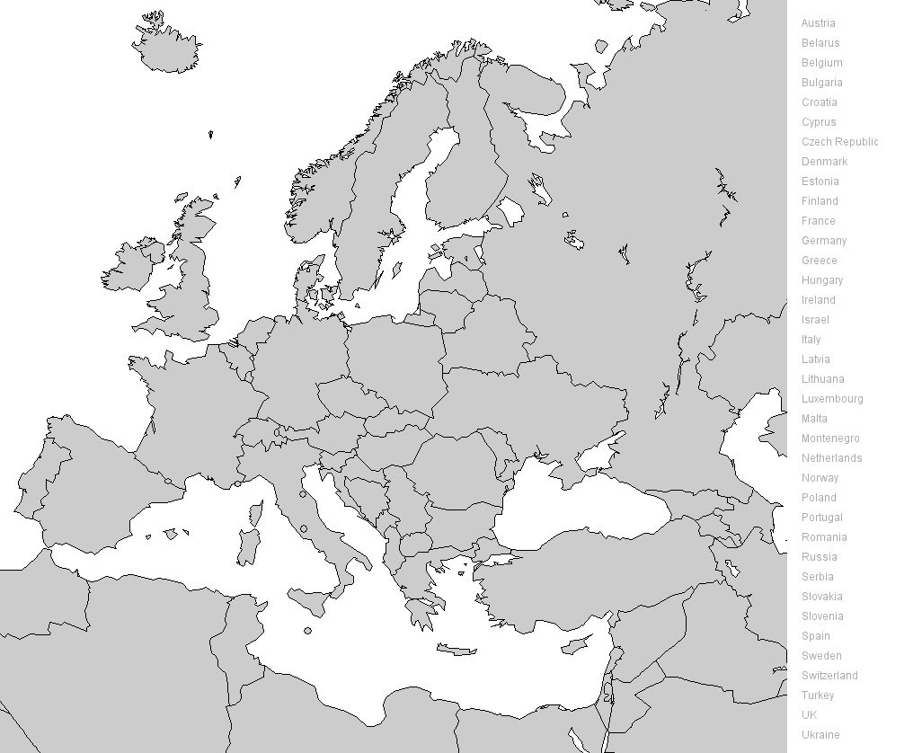
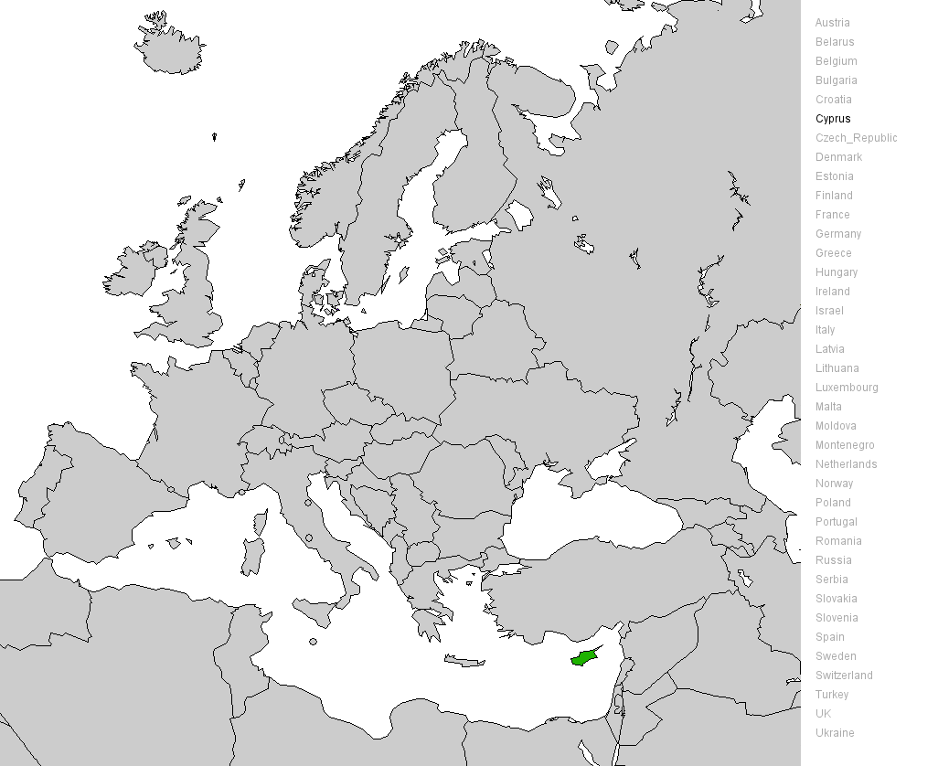
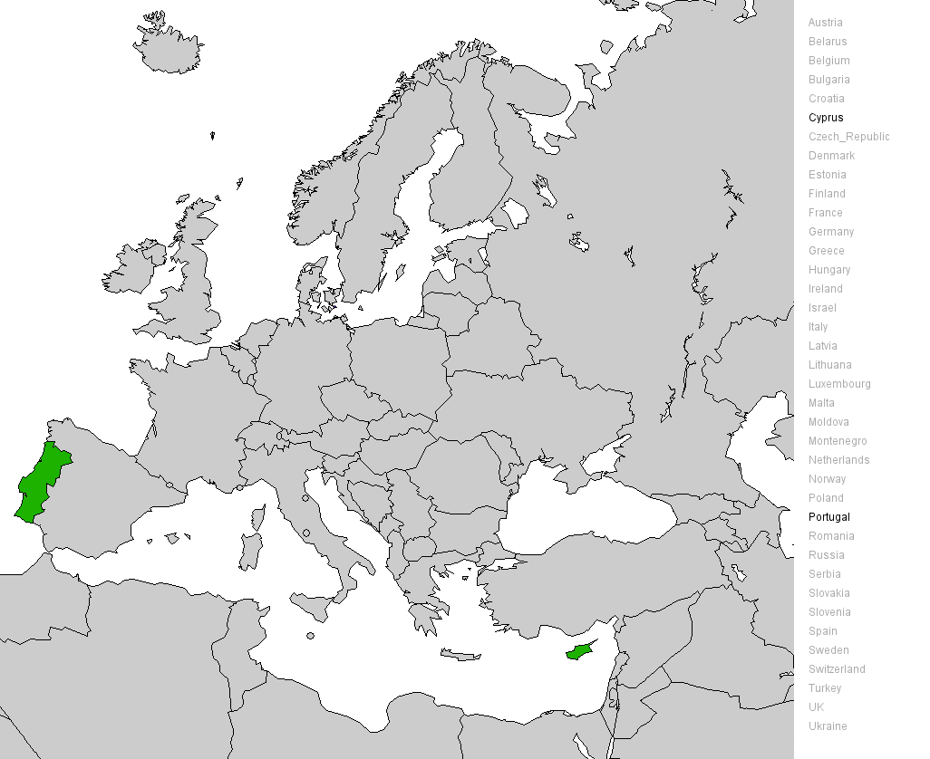
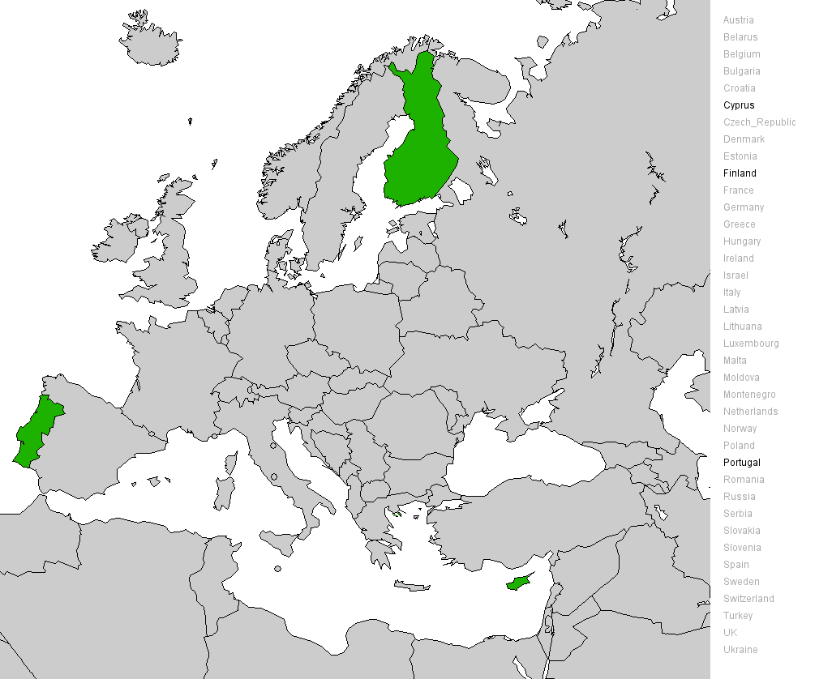
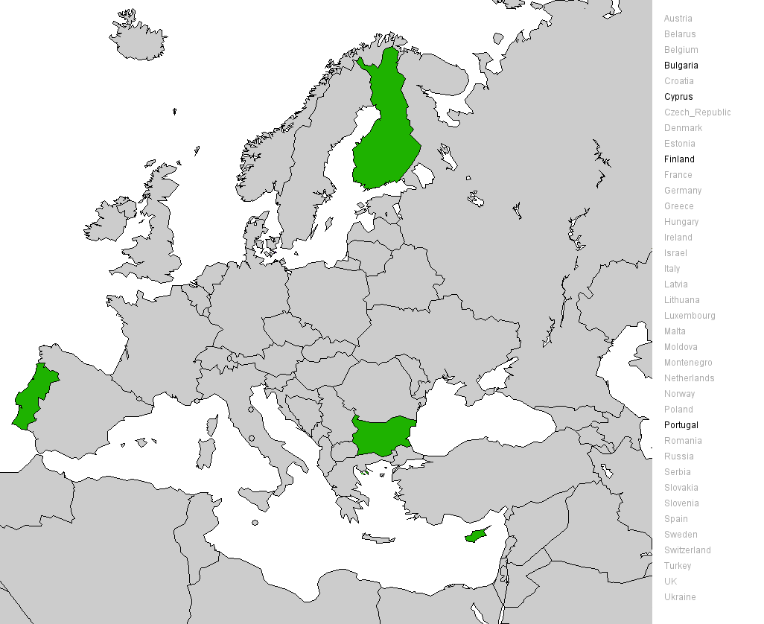

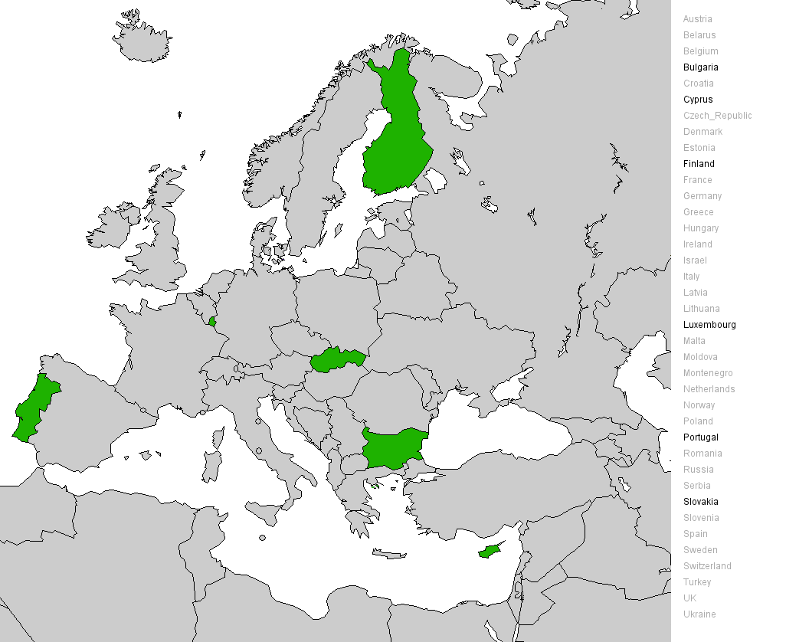
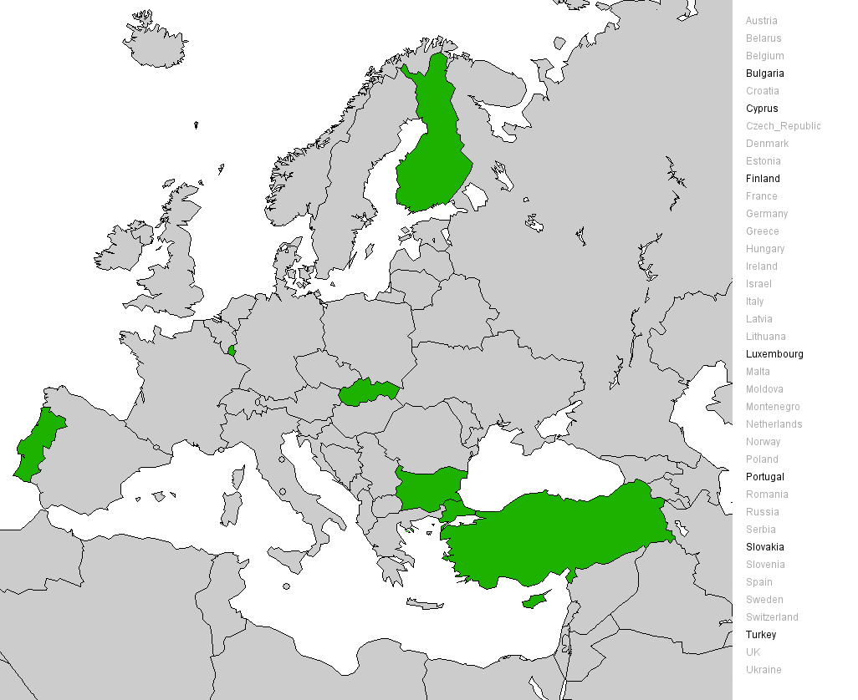
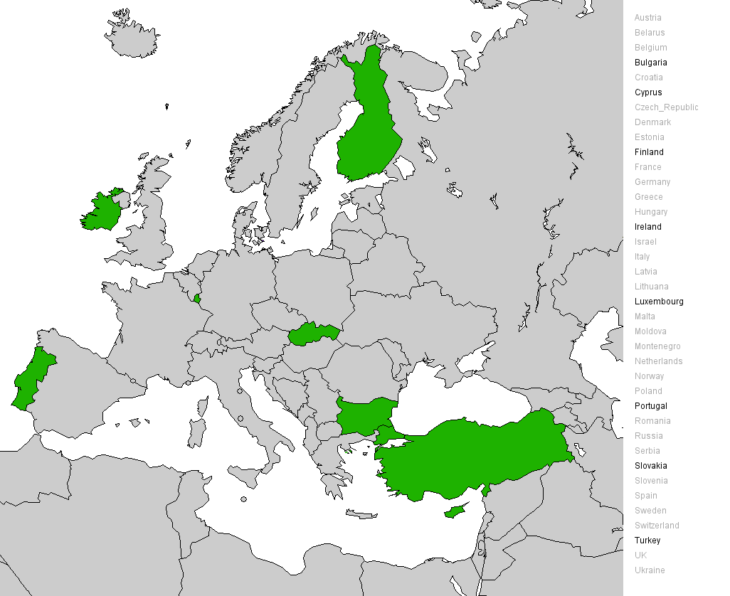
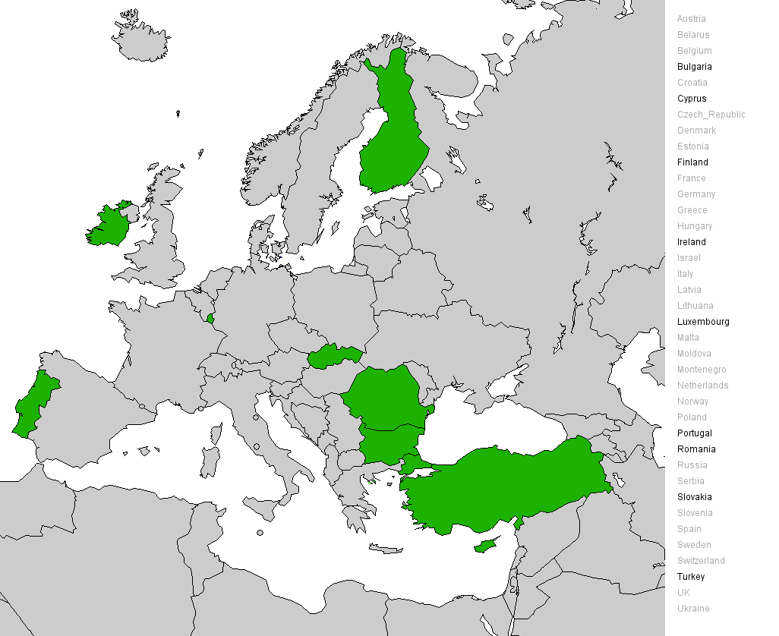
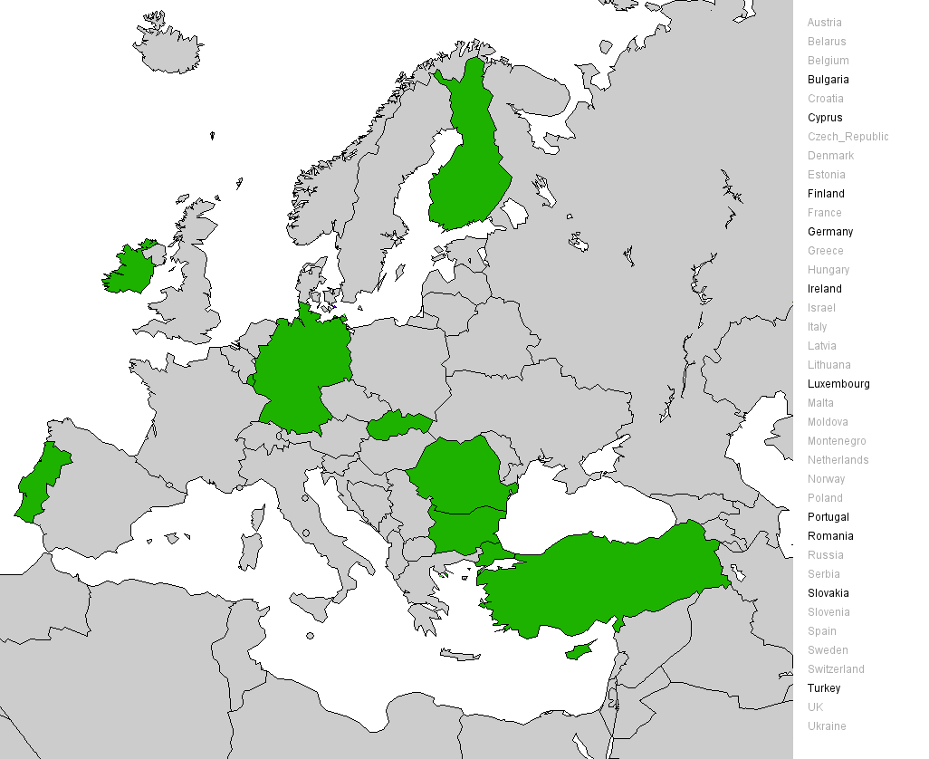
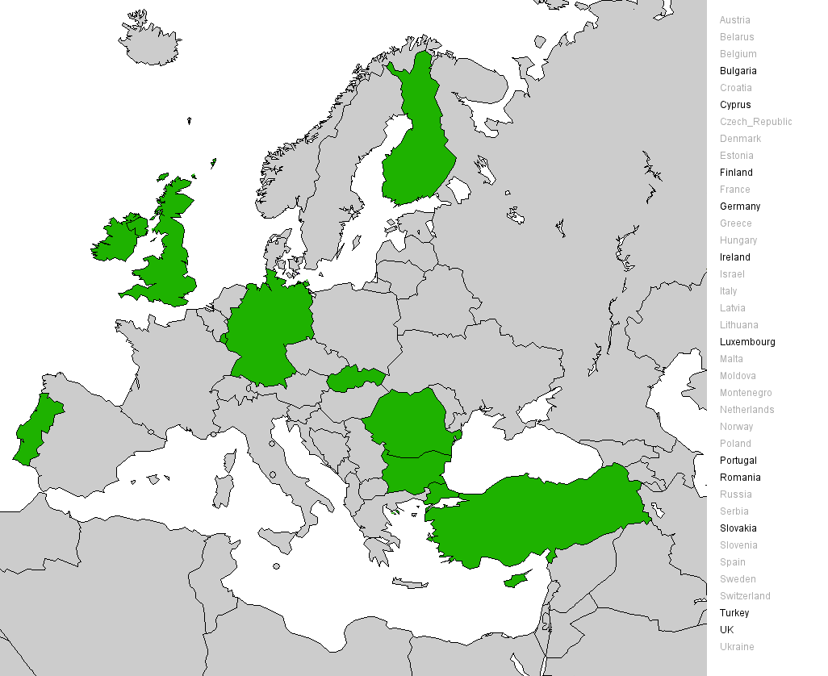
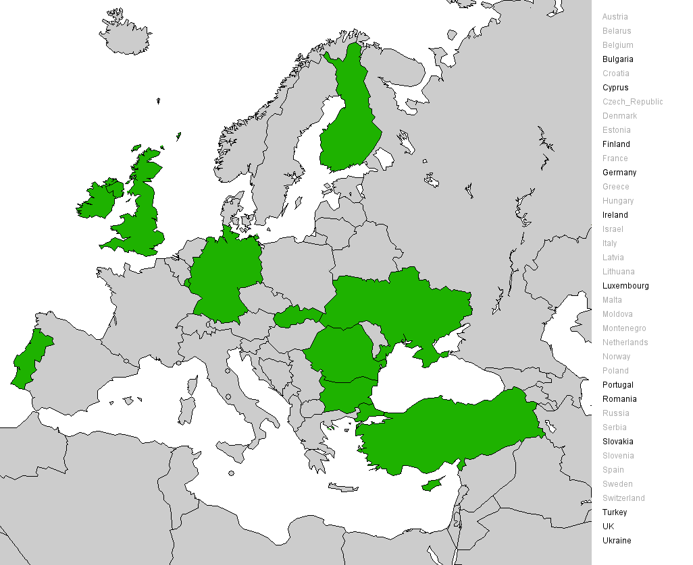
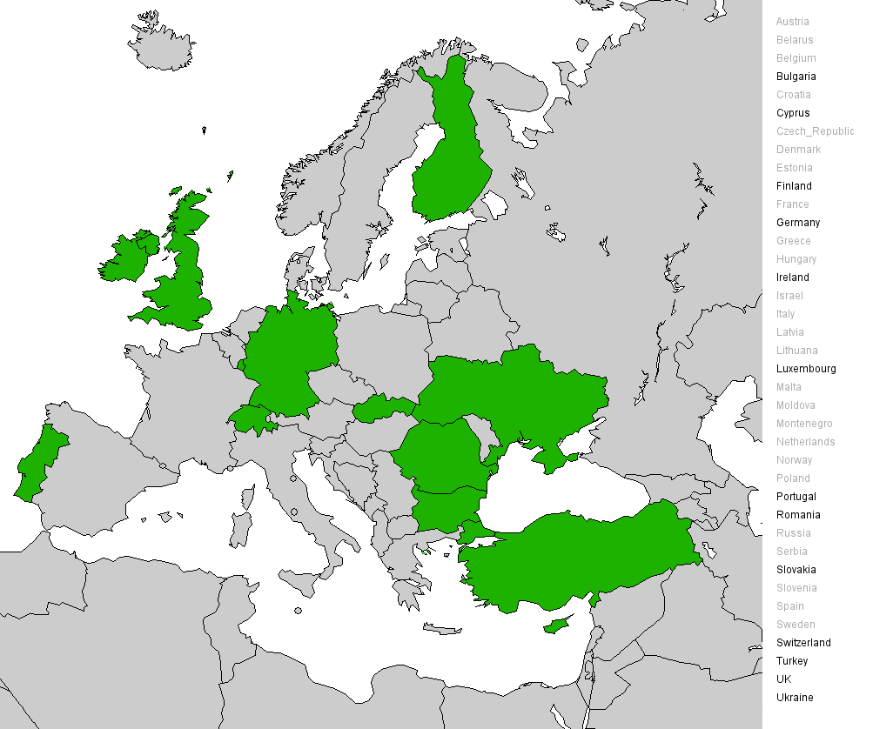

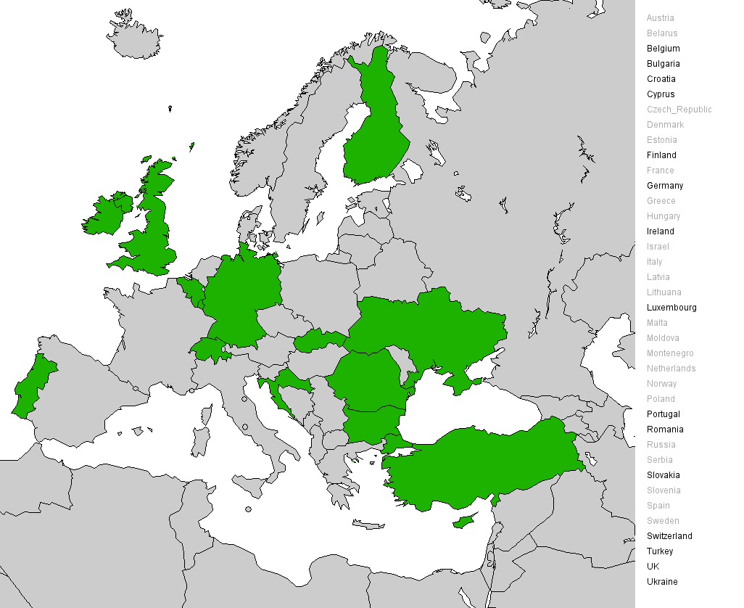
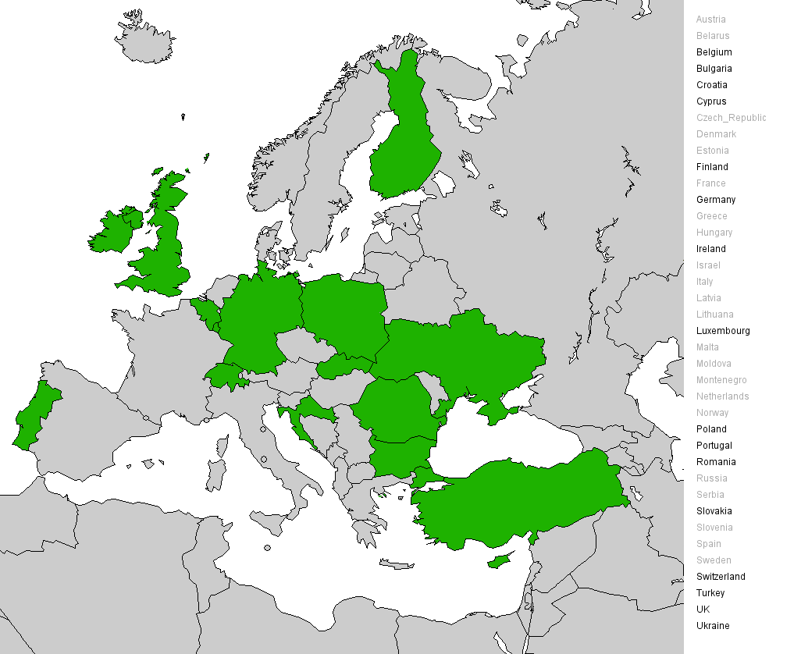
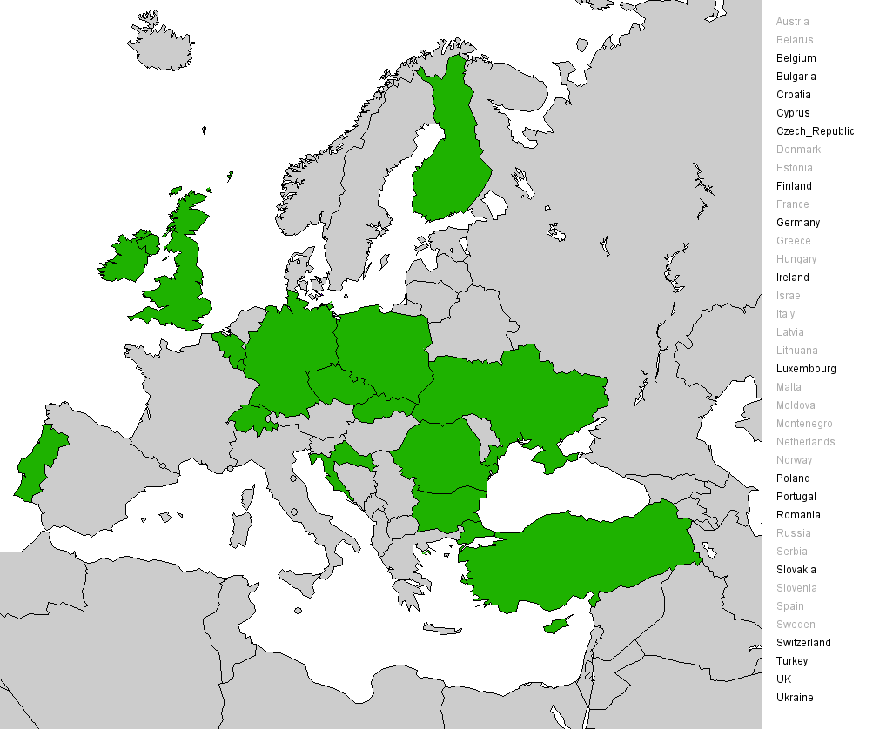

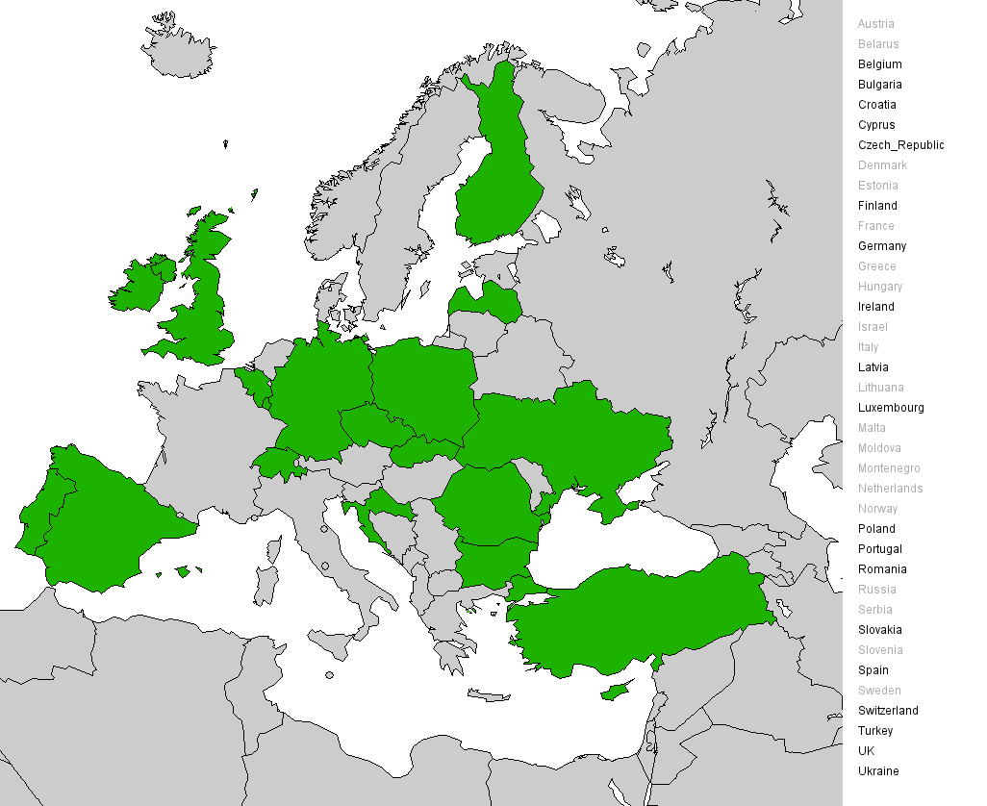

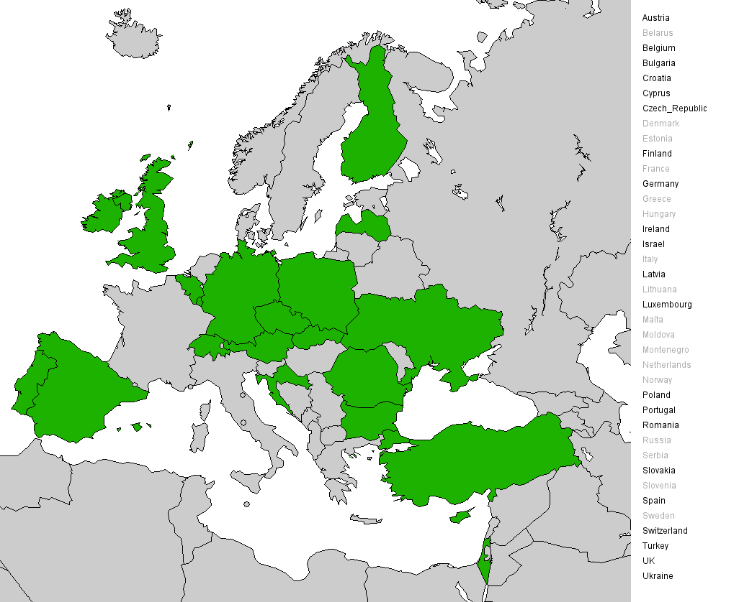
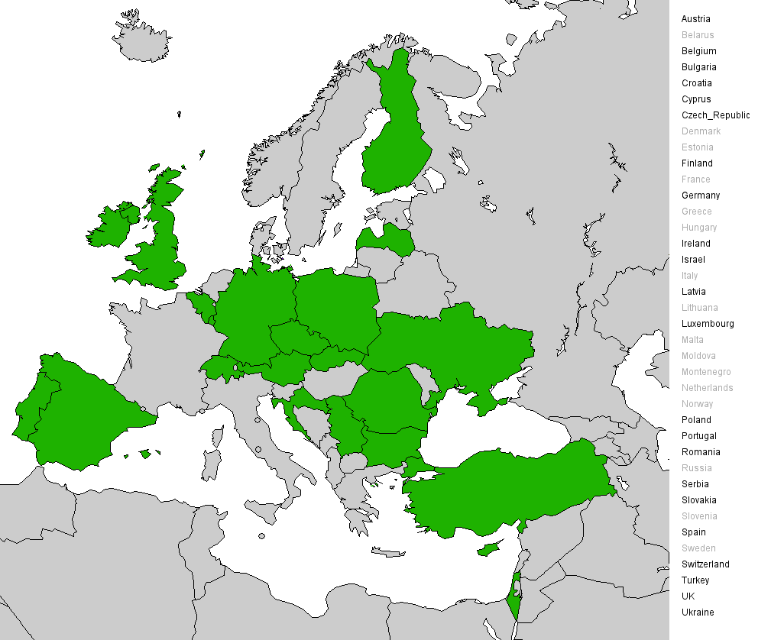
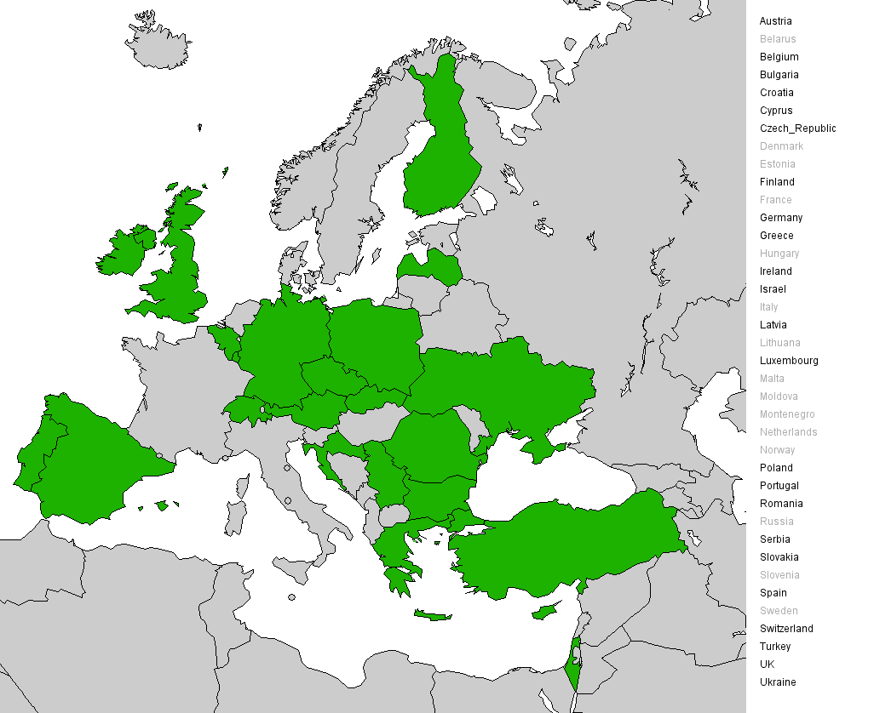
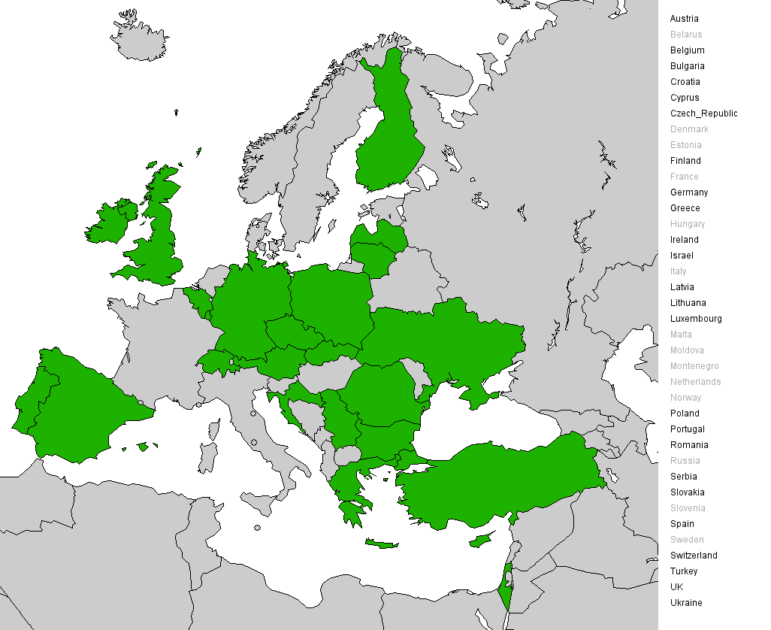
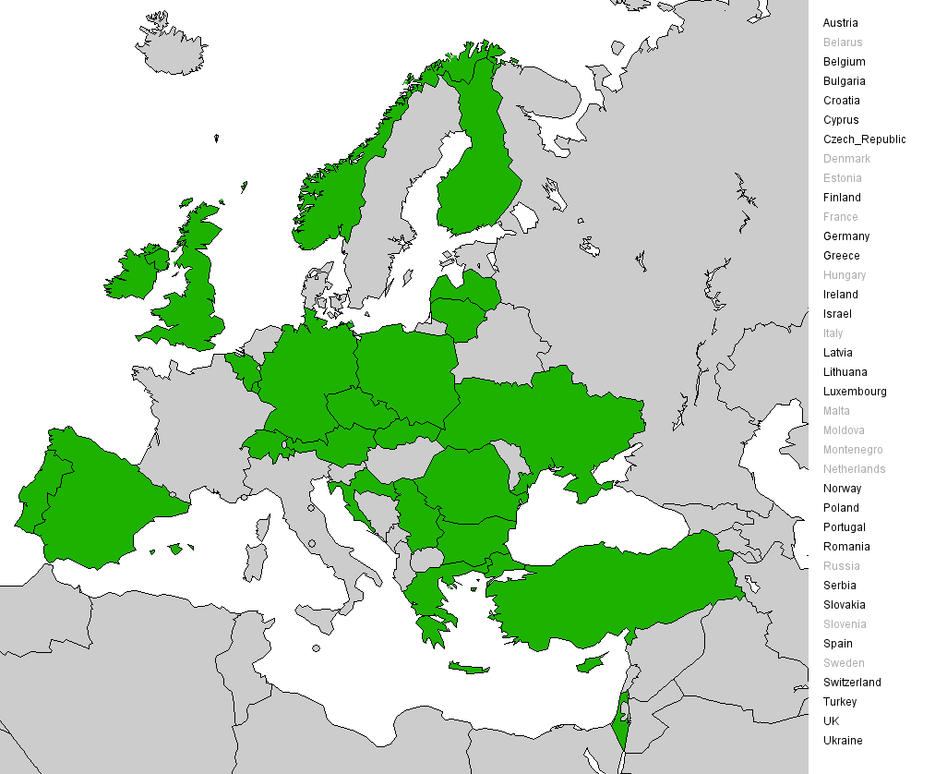

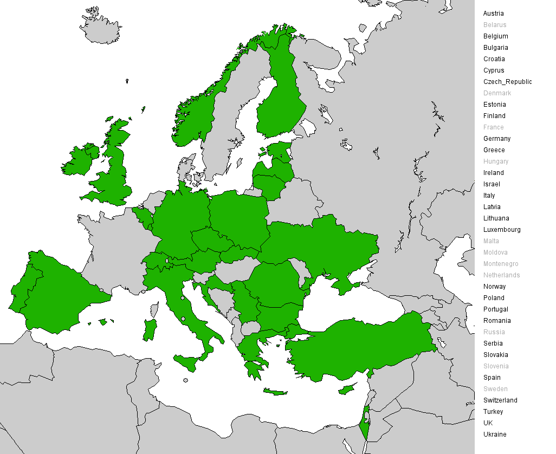

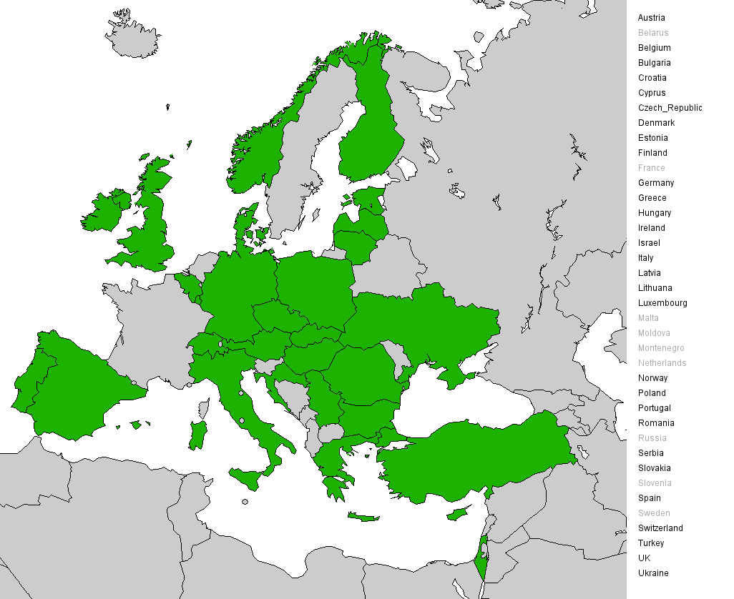
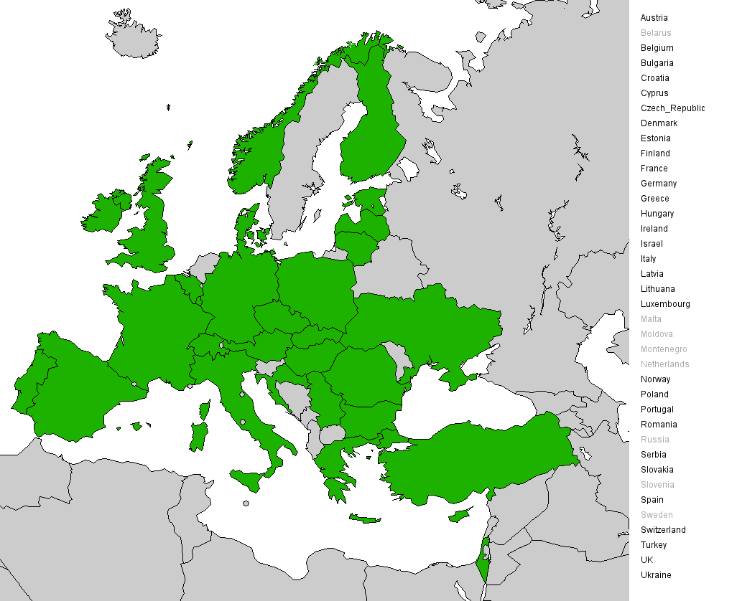

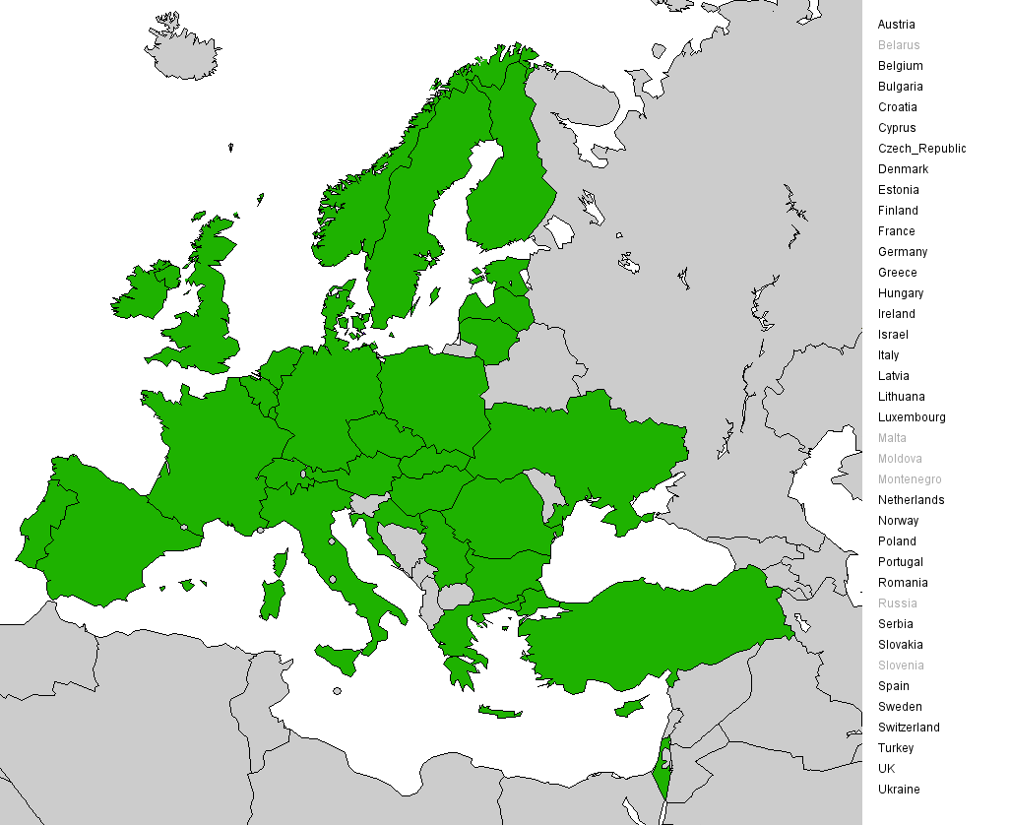
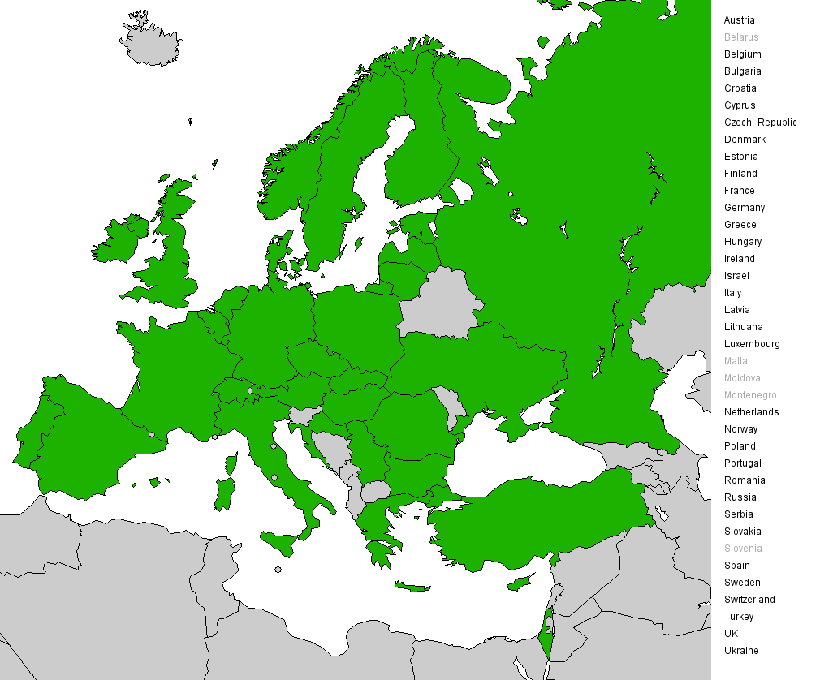

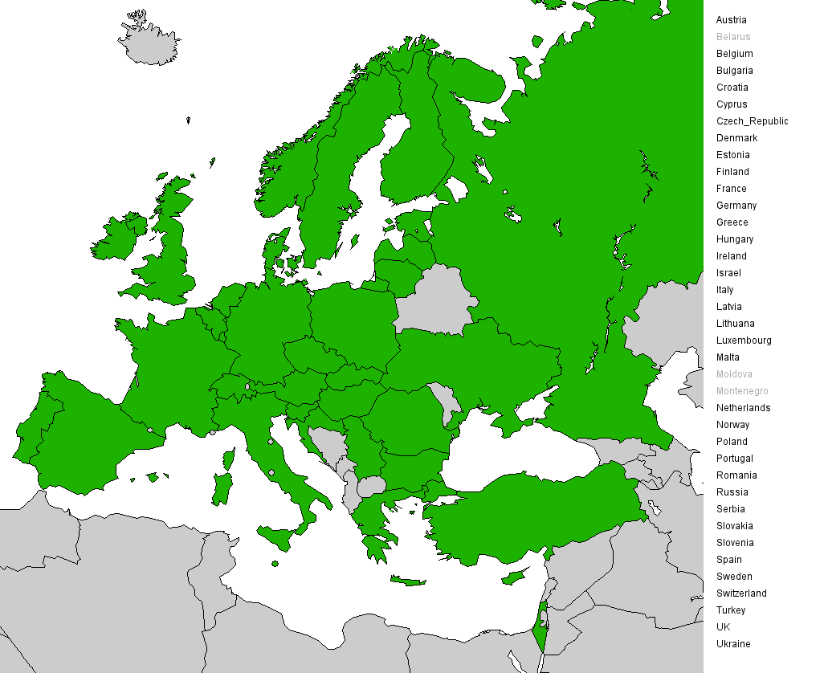



38 European NGIs
+ Asia, US, Latin America
+ PRACE
+ OGF-Europe
+ …

Slide 21
EGI Design Study
Project proposal:
submitted to FP7-INFRASTRUCTURES-2007-1,
1.2.1 Design Studies
Goal:
Conceptual setup and operation of a new organizational model of a sustainable pan-European grid infrastructure
Consortium: 9 Partners ➔ EGI Preparation Team

Slide 22
EGI Preparation Team
Members:
Johannes Kepler Universität Linz (GUP)
Greek Research and Technology Network S.A. (GRNET)
Istituto Nazionale di Fisica Nucleare (INFN)
CSC - Scientific Computing Ltd. (CSC)
CESNET, z.s.p.o. (CESNET)
European Organization for Nuclear Research (CERN)
Verein zur Förderung eines Deutschen Forschungsnetzes - DFN-Verein (DFN)
Science & Technology Facilities Council (STFC)
Centre National de la Recherche Scientifique(CNRS)

Slide 23
EGI Design Study
Project proposal:
submitted to FP7-INFRASTRUCTURES-2007-1,
1.2.1 Design Studies
Goal:
Conceptual setup and operation of a new organizational model of a sustainable pan-European grid infrastructure
Consortium: 9 Partners ➔ EGI Preparation Team
NGI Representatives ➔ EGI Advisory Board
Person months: ~300
Duration: 1 Sept 2007 – 30 Nov 2009 (27 Months)

Slide 24
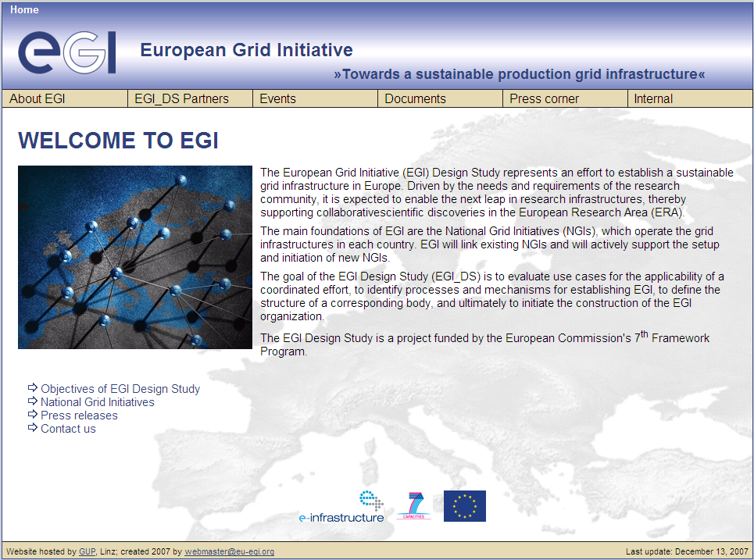
EGI Webpage www.eu-egi.org

Slide 25
Work Distribution
WP2: EGI Requirements Consolidation
(Fotis Karayannis, GRNET)
WP3: EGI functionality definition
(Laura Perini, INFN)
WP4: Study of EGI legal and organisational options
(Beatrice Merlin, CNRS)
WP5: Establishment of EGI
(Jürgen Knobloch, CERN)
WP6: EGI Promotion and Links with Other Initiatives
(Per Öster, CSC)

Slide 26
EGI Design Study
Chronology:
October 2006: EGEE appoints EGI Coordinator
February 26-27, 2007: EGI Workshop Munich
May 2, 2007: Proposal submitted to the EC within FP7-INFRA-2007-1, 1.2.1 Design Studies
Sept. 1, 2007: Project start
Oct. 2, 2007:
➔EGI Workshop, Budapest, Hungary
“Requirements consolidation and use case definition”
http://www.eu-egi.org/events/workshop/oct07

Slide 27
EGI Workshop Summary:
Use Cases
Attended by NGI representatives and other communities
First set of EGI use cases gathered and summarised:
  Invitation distributed to NGIs, application communities, related projects, operators, etc.
  Total: 26 replies
  (11 out 37 NGIs replied, plus 15 other replies from projects, application communities, institutes)
  The actual use cases are much more
  (1 to 8 use cases each reply)
Summary of use cases available in the EGI Knowledge Base (http://knowledge.eu-egi.org)
Goal: Continuous collection of use cases

Slide 28
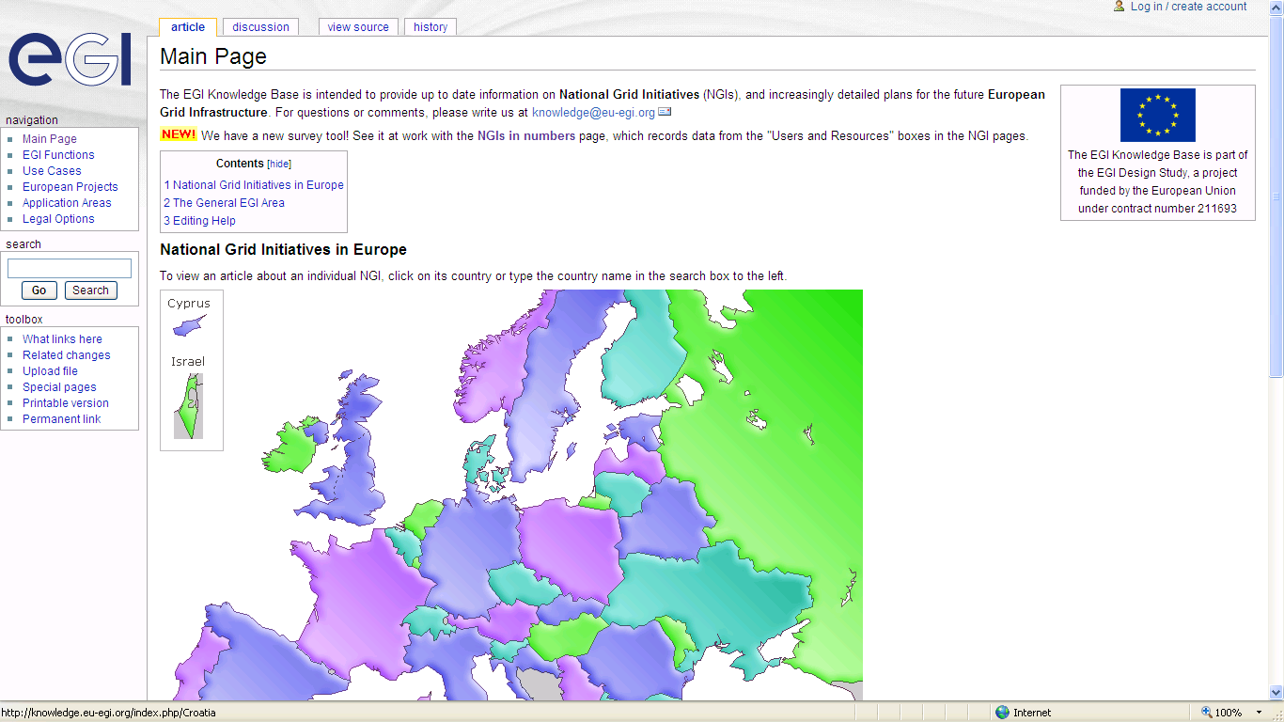
EGI Knowledge Base - Main
NGI Representatives to provide their input
and update their local information
http://knowledge.eu-egi.org

Slide 29
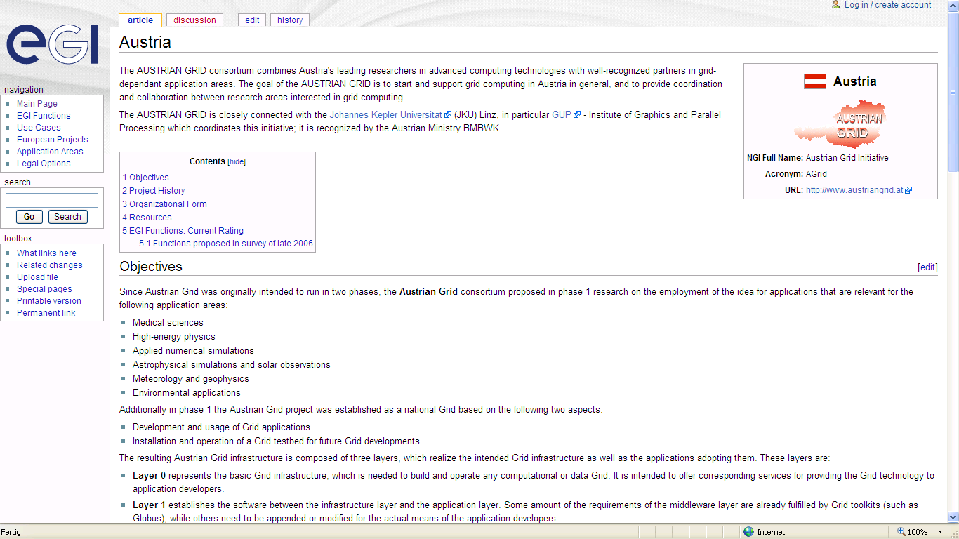
EGI Knowledge Base Austria

Slide 30
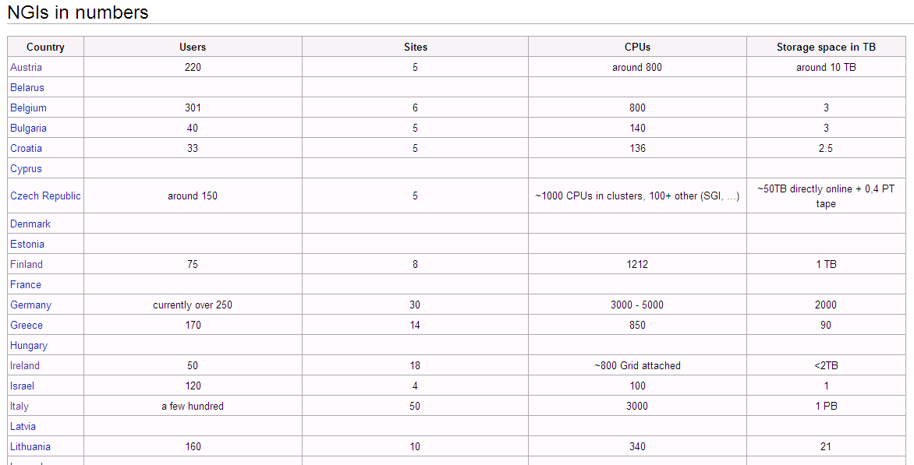
EGI Knowledge Base

Slide 31
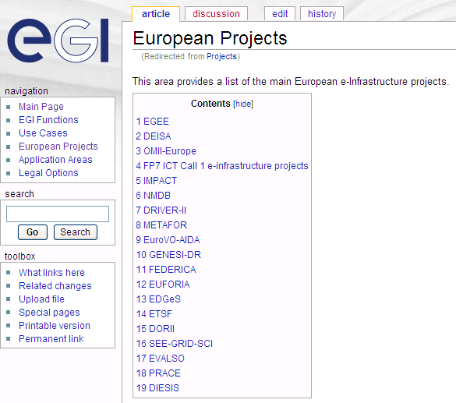
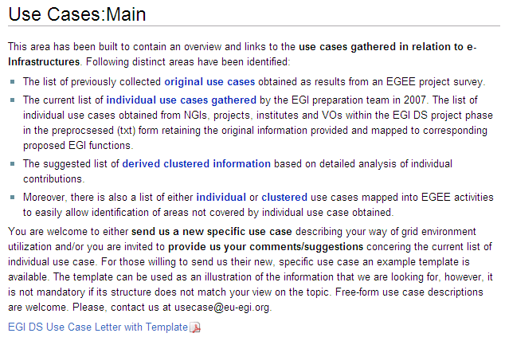
EGI Knowledge Base

Slide 32
Upcoming Deliverables & Milestones
Mar 2008:
Draft definition and convention of EGI organization
EGI Workshop, 13-14 March, Rome, Italy
„List of EGI functions and working model“
Apr 2008: Guidelines for NGIs
June 2008: EGI Blueprint publication
2010: EGI Organization in place

Slide 33
EGI Functionality Overview
Management, Outreach & Dissemination - Representation of EU Grid Efforts
Operations & Resource Provisioning & Security
Application Support & Training
Middleware (Build&Test, Component Selection/Validation/Deployment)
Standardisation & Policies
Industry take-up

Slide 34
EGI Managment Structure
EGI
Political Bodies
such as:
eIRG,
EU,
ESFRI,
Ntl. Bodies,
...
Strategy Cttee
EGI Council
Advisory Committees
Director + staff
CTO
(Developments)
CAO
(Admin.+ PR)
COO
(Operations)
Dev.
Group
Adm.+PR
Group
Oper.
Group
EGI Organisation

Slide 35
EGI Operations
DRAFT
NGIs perform operations of their national grid infrastructure, including monitoring and accounting, following a general SLA
Each NGI has full responsibility towards other NGIs but acts independently
EGI provides coordination level to guarantee effective, integrated operations through the adoption of standard services
Discussion on-going

Slide 36
EGI Resource Strategy
DRAFT
EGI owns very few hardware resources
Resource provisioning is responsibility of NGIs ➔ Freedom to choose whatever resources to offer
Development of a strategy for simple entry of new Virtual Organizations
Discussion on-going

Slide 37
EGI Middleware
DRAFT
Convergence of middleware stacks towards full interoperability (through general standards interfaces)
Distinction between core and high-level functions ➔ EGI coordinates core services
  Standards-compliance test for core services provided by EGI
  Common build&test system needed in Europe
Discussion on-going

Slide 38
EGI Application Support
DRAFT
Application support implemented and provided by NGIs
EGI performs coordination role
  Validation of user support by NGIs
  Facilitating experts between NGIs
  Organization of user forums
EGI to coordinate training events
Discussion on-going

Slide 39
EGI Finances
The EGI organisation has three major and separate cost centres: (1) general central services, (2) service provisioning and (3) developments
(1) will be funded through contributions, (2) will be funded through service charges (3) will be funded through project grants.
There are in general no cross-subsidies possible between these cost centres.

Slide 40
EGI – European Grid Initiative
Future EGI Organisation = “Glue” between various grid communities in Europe and beyond
EGI_DS defines required mechanisms and functionalities of the EGI Organisation
➔ Towards a sustainable environment for the application communities utilizing grid infrastructures for their everyday work

Slide 41
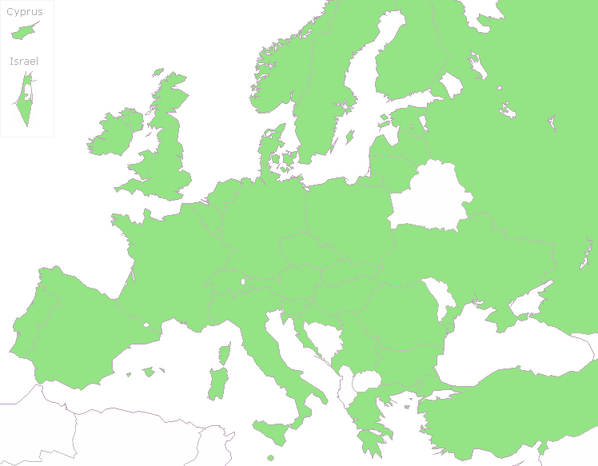




http://www.eu-egi.org
contact@eu-egi.org

